Slide 1
formal Proof with Rodin
Li Qin
Software Engineering Institute

Slide 2

Formal Proof
Consider a proof process as a state transition system $S=(Q,Σ,→,q_{0})$
Every state is a sequent
Every edge is a label of an inference rule
Transition function is defined from inference rules
A proof is done (fail) when the system terminates
s1
s2
s3
s4
s5
s6
s4
s4

Slide 3




Sequent
Sequent：$H⊢G$
A reasoning (proof) from Hypotheses to Goals
H and G are formulas
Example:
Sequent means a state of a proof,
It holds or not depends on the proof process
$$P, P⇒Q⊢Q$$
$$P⇒Q⊢¬Q⇒¬P$$
$$⊢P⇒¬P$$

Slide 4
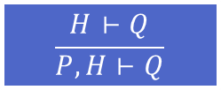

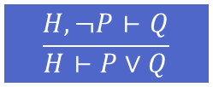
Inference rule
Inference Rule：$\frac{A}{C}$
A inference from assumptions to conclusions
A and C are sets of sequents
A transition from C to A according to $\frac{A}{C}$
In order to get a proof of C, it is sufficient to have proofs of each sequent in A
Examples:
A set of inference rules stands for a proof theory
They are considered to be always true in the proof system
$$\frac{H⊢Q}{P,H⊢Q}$$
$$\frac{H,¬P⊢Q}{H⊢P∨Q}$$

Slide 5

Algorithm for Proof
Input: the sequent S to be proved
Output: Proved or Not Proved
Database: A set of inference rules
Algorithm:
A container K initially has sequent S
Search the inference rule in the database
Replace S with A in K
Repeat from step 2
If K is empty, the proof succeeds; If no proper inference rule can be found to proceed, the proof fails
$$\frac{A}{S}$$

Slide 6
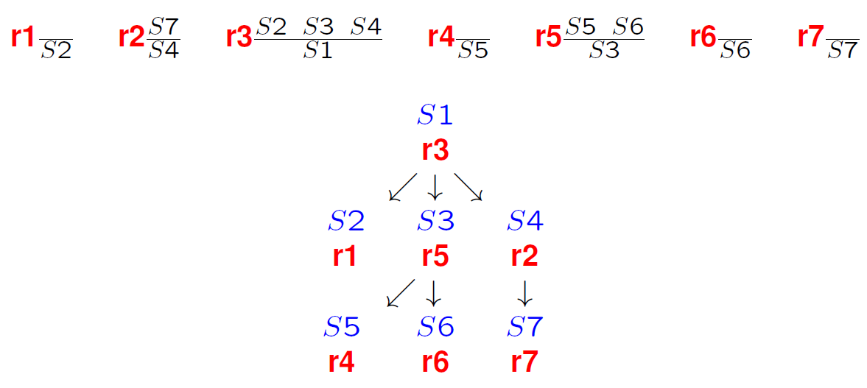
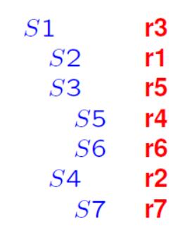
Proof Tree
You can see this form in Rodin tool

Slide 7
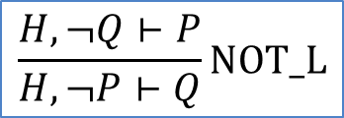
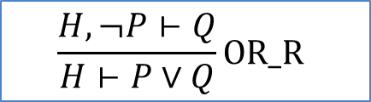
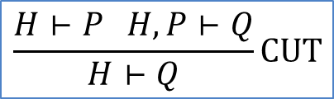
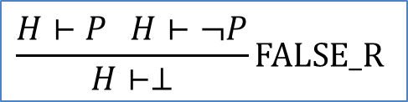
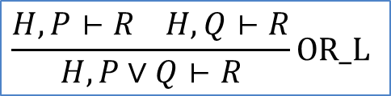
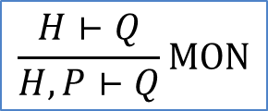
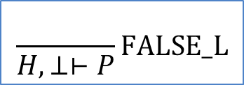
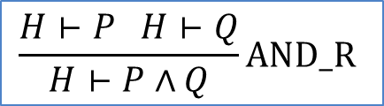
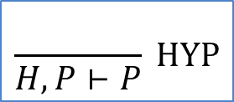
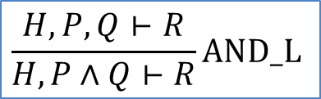
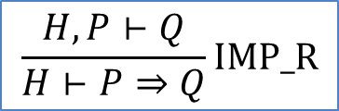
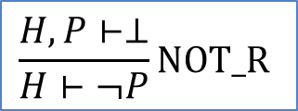
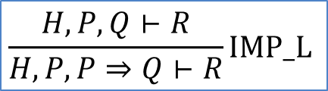
Inference Rules for Propositional Logic
$$\frac{}{H,P⊢P} HYP$$
$$\frac{H⊢Q}{H,P⊢Q}MON$$
$$\frac{H⊢P H,P⊢Q}{H⊢Q}CUT$$
$$\frac{}{H,⊥⊢P}FALSE_L$$
$$\frac{H⊢P H⊢¬P}{H⊢⊥}FALSE_R$$
$$\frac{H,¬Q⊢P}{H,¬P⊢Q}NOT_L$$
$$\frac{H,P⊢⊥}{H⊢¬P}NOT_R$$
$$\frac{H,P,Q⊢R}{H,P∧Q⊢R}AND_L$$
$$\frac{H⊢P H⊢Q}{H⊢P∧Q}AND_R$$
$$\frac{H,P⊢R H,Q⊢R}{H,P∨Q⊢R}OR_L$$
$$\frac{H,¬P⊢Q}{H⊢P∨Q}OR_R$$
$$\frac{H,P,Q⊢R}{H,P,P⇒Q⊢R}IMP_L$$
$$\frac{H,P⊢Q}{H⊢P⇒Q}IMP_R$$

Slide 8

Example
Prove sequent $\left(A⇒C\right)∧\left(B⇒C\right)⊢(A∨B⇒C)$
$\left(A⇒C\right)∧\left(B⇒C\right)⊢(A∨B⇒C)$ IMP_R
$\left(\left(A⇒C\right)∧\left(B⇒C\right)\right), (A∨B)⊢C$ AND_L
$\left(A⇒C\right),\left(B⇒C\right),\left(A∨B\right)⊢C$ OR_L
$\left(A⇒C\right),\left(B⇒C\right),A⊢C$ IMP_L
$C,\left(B⇒C\right),A⊢C$ HYP
Done
$\left(A⇒C\right),\left(B⇒C\right),B⊢C$ IMP_L
$\left(A⇒C\right),C,B⊢C$ HYP
Done

Slide 9
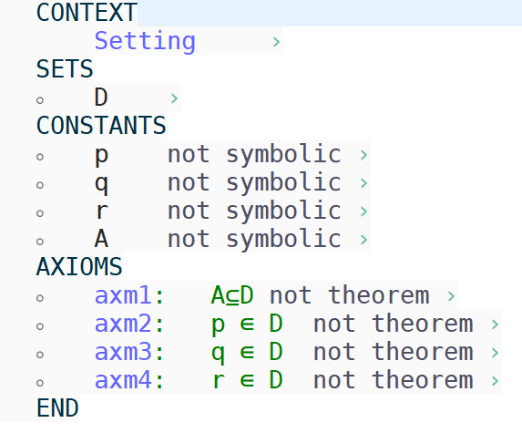
Proof in Rodin
Set proof environment

Slide 10
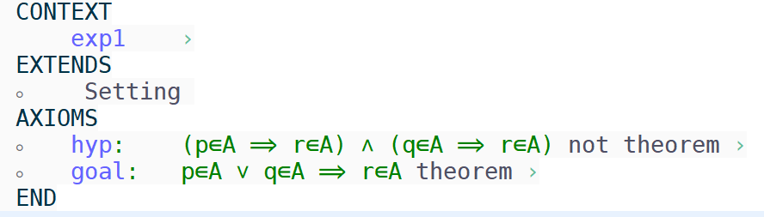
Proof in Rodin
Encode the sequent you want to prove

Slide 11
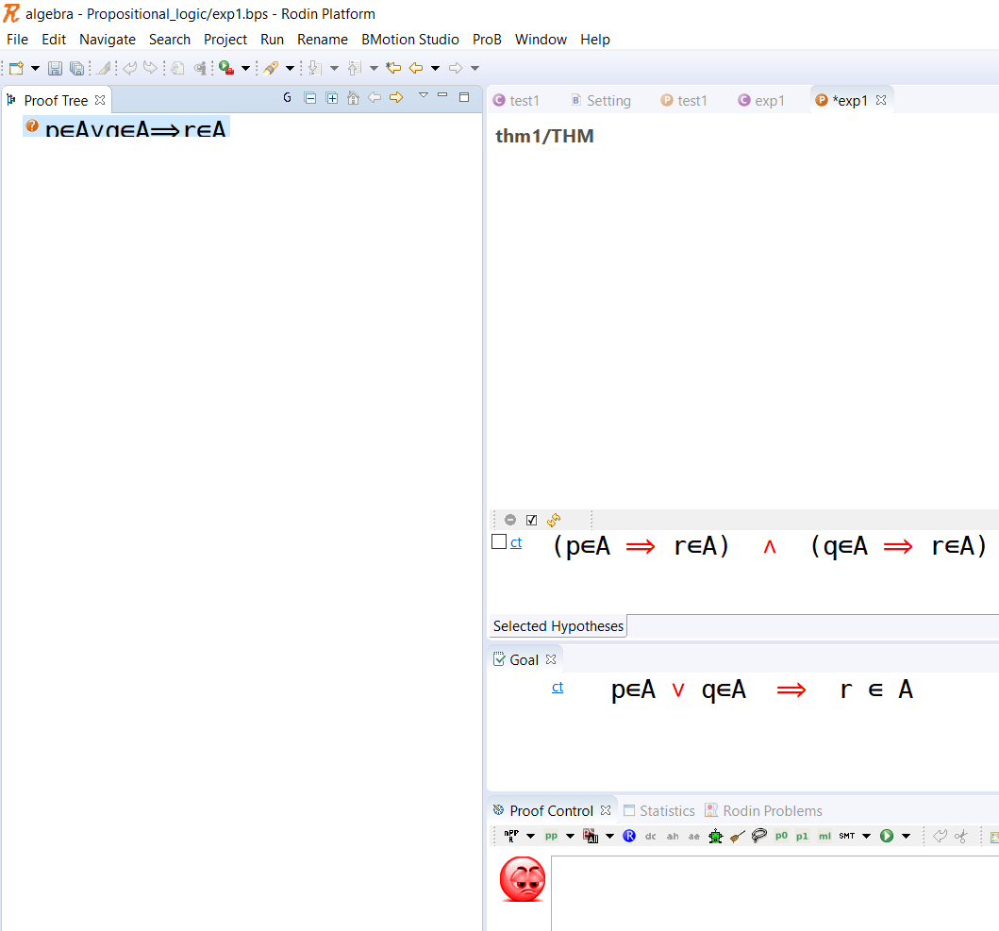
Proof In Rodin
Start Proof
Note the Red symbols

Slide 12
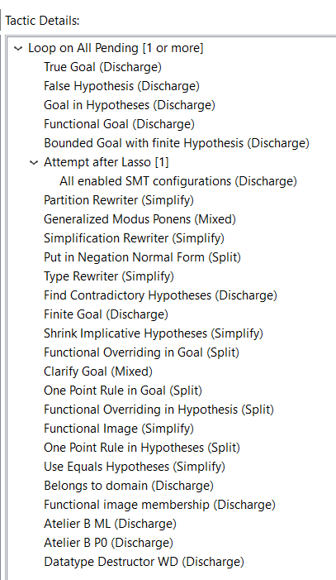



Proof in Rodin
Automatic Proof
Tactic Profile
SMT Solver
Manual Proof
Red symbols ⬄ inference rules
Deduction ⬄
Proof by cases ⬄
Apply MP ⬄
$$\frac{H,P⊢Q}{H⊢P⇒Q}IMP_R$$
$$\frac{H,P⊢R H,Q⊢R}{H,P∨Q⊢R}OR_L$$
$$\frac{H,P,Q⊢R}{H,P,P⇒Q⊢R}IMP_L$$

Slide 13
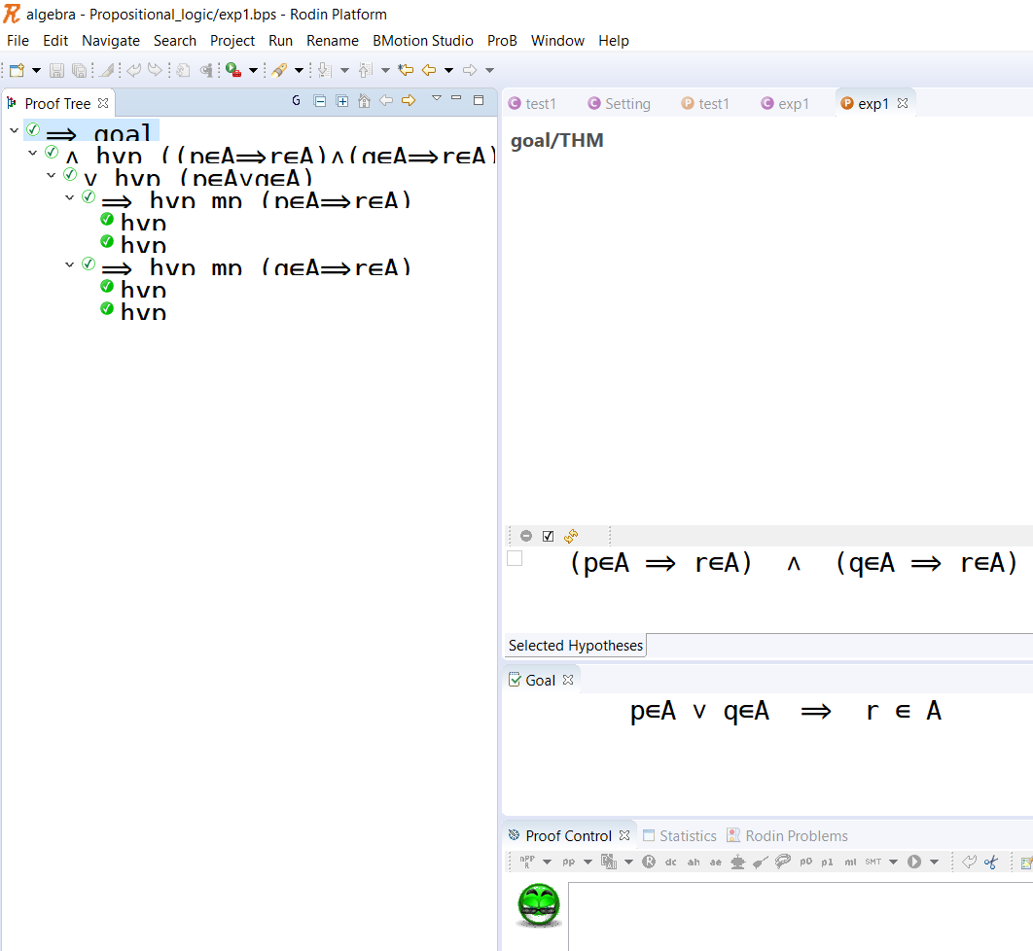
Proof in Rodin
Proof Done

Slide 14

Exercise
Prove the following sequent in Rodin manually
$¬\left(p∧q\right)⊢¬p∨¬q$
$\left(p∨q\right)⇒r⊢\left(p⇒r\right)∧(q⇒r)$
$\left(p∨r\right)∧\left(q∨r\right)⊢\left(p∧q\right)∨r$

Slide 15
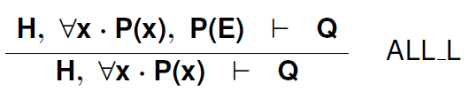


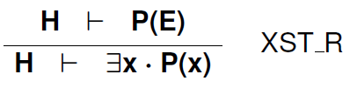




Inference Rules for Predicate Logic

Slide 16

Example
Proof $∀x⋅\left(∃y⋅P\left(x,y\right)\right)⇒Q\left(x\right)⊢∀x⋅(∀y⋅P\left(x,y\right)⇒Q(x))$
$∀x⋅\left(∃y⋅P\left(x,y\right)\right)⇒Q\left(x\right)⊢∀y⋅P\left(x,y\right)⇒Q(x)$ ALL_R
$∀x⋅\left(∃y⋅P\left(x,y\right)\right)⇒Q\left(x\right)⊢P\left(x,y\right)⇒Q(x)$ IMP_R
$∀x⋅\left(∃y⋅P\left(x,y\right)\right)⇒Q\left(x\right), P\left(x,y\right)⊢Q(x)$ CUT
$∀x⋅\left(∃y⋅P\left(x,y\right)\right)⇒Q\left(x\right), P\left(x,y\right)⊢∃y⋅P(x,y)$ XST_R
$∀x⋅\left(∃y⋅P\left(x,y\right)\right)⇒Q\left(x\right), P\left(x,y\right)⊢P(x,y)$ HYP
$∀x⋅\left(∃y⋅P\left(x,y\right)\right)⇒Q\left(x\right), P\left(x,y\right), ∃y⋅P\left(x,y\right)⊢Q(x)$ ALL_L
$\left(∃y⋅P\left(x,y\right)\right)⇒Q\left(x\right), P\left(x,y\right), ∃y⋅P\left(x,y\right)⊢Q(x)$ IMP_L
$Q\left(x\right), P\left(x,y\right), ∃y⋅P\left(x,y\right)⊢Q(x)$ HYP

Slide 17
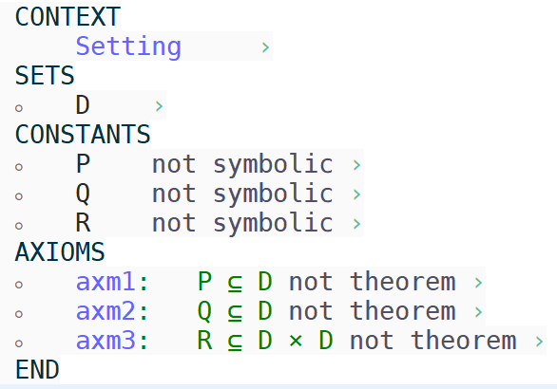
Proof in Rodin
Set Proof Environment

Slide 18
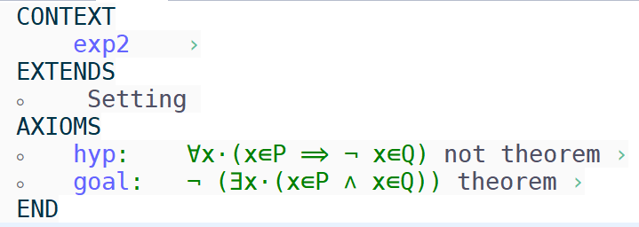
Proof in Rodin
Encode the sequent you want to prove

Slide 19
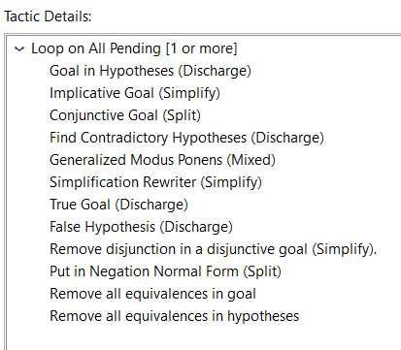
Proof in Rodin
Set Auto Proof Tactics

Slide 20
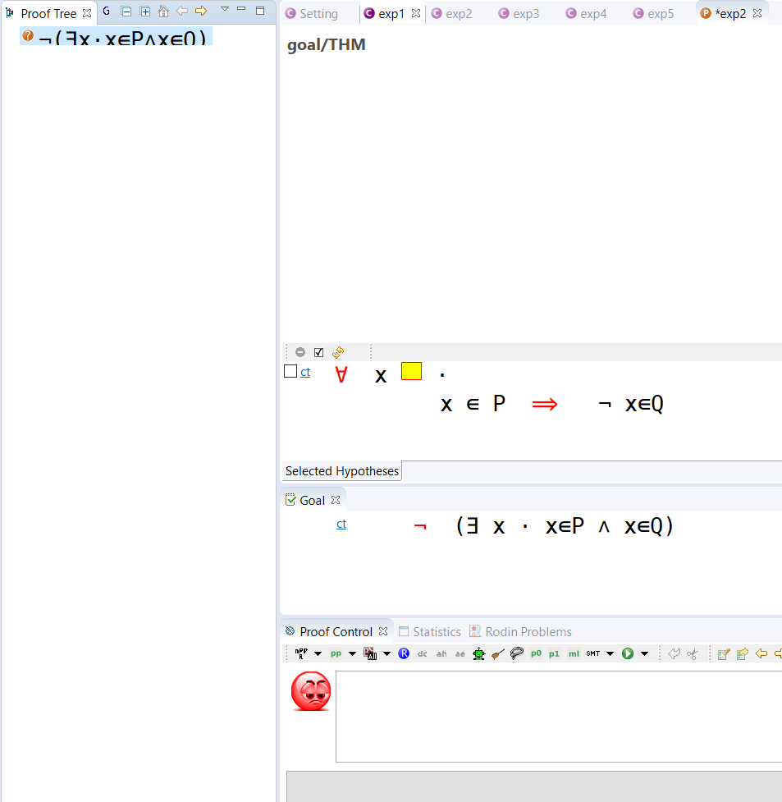
Proof in Rodin
Start Proof
Note the yellow box for instantiating the bounded variable x

Slide 21
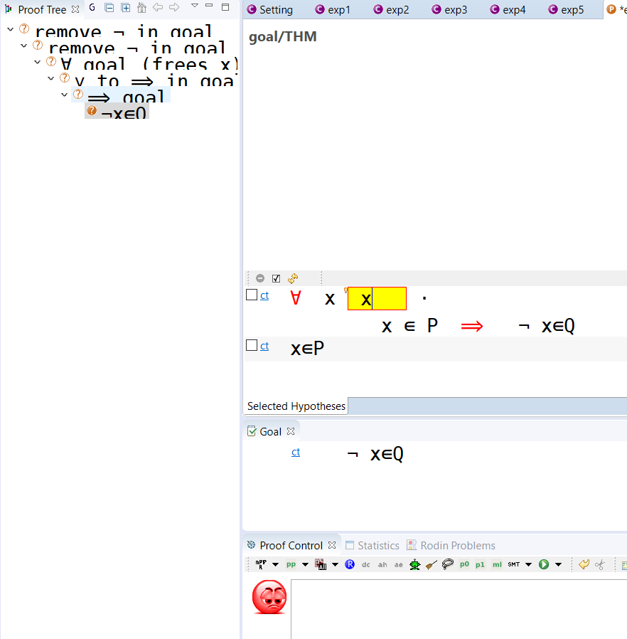
Proof in Rodin
Find an instance for variable x to finish the proof

Slide 22
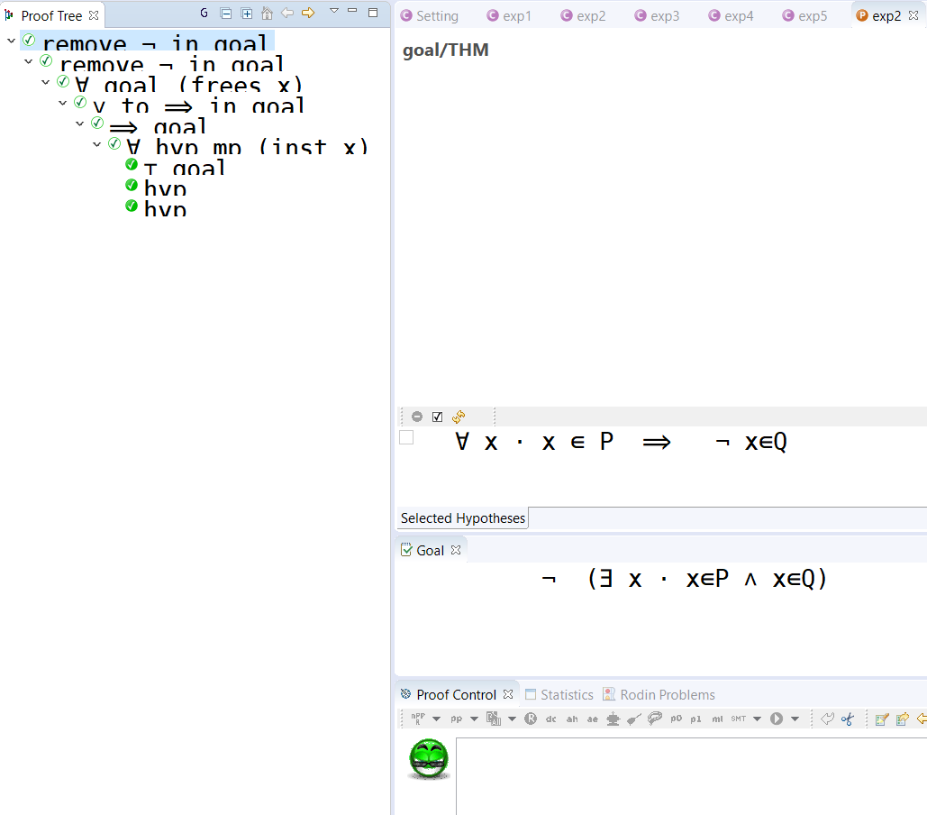
Proof in Rodin
Proof Done

Slide 23

Exercise
Prove the following sequent in Rodin manually
$∀x⋅\left(∃y⋅P\left(x,y\right)\right)⇒Q\left(x\right)⊢∀x⋅(∀y⋅P\left(x,y\right)⇒Q(x))$
$∀x∀y∀z⋅R\left(x,y\right)∧R\left(y,z\right)⇒R\left(x,z\right),$ $∀x∀y⋅R\left(x,y\right)⇒R\left(y,x\right),$ $∀x⋅\left(∃y⋅R\left(x,y\right)\right)$ $⊢∀x⋅R(x,x)$
$∀x∀y∀z⋅R\left(x,z\right)∧R\left(y,z\right)⇒R\left(x,y\right),$ $∀x⋅\left(∃y⋅R\left(x,y\right)\right)$ $⊢∀x∀y∀z⋅R\left(x,y\right)∧R\left(y,z\right)⇒R\left(x,z\right)$

